Slide 1
Samsung Innovation Campus
Artificial Intelligence Course
Notes:
Note:
1

Slide 2
Song Lyrics Generator
Project Presented by :
Ali Mohamed Hashish Hesham Ahmed El-Hawash
Team :
Code Crackers
Data Used :
https://www.kaggle.com/neisse/scrapped-lyrics-from-6-genres
Notes:
Note:
2

Slide 3

Song Lyrics Generator

Slide 4
Agenda
Introduction
Data Description
Inspiration
Design Thinking
Data Features
Data Analysis
Modelling
Predictions
Business Solutions
Notes:
Note:
4

Slide 5
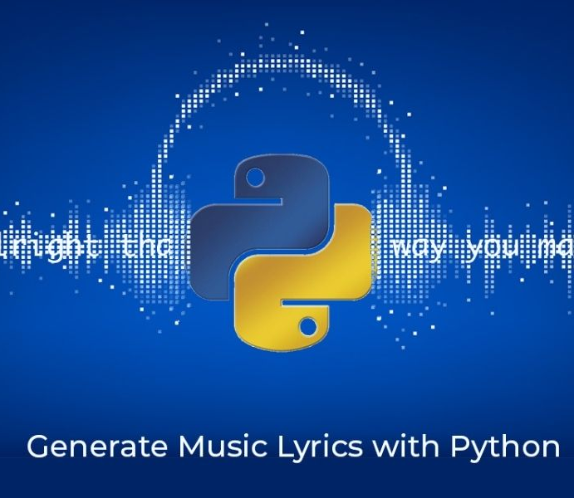
Introduction
Text generation is a relatively new topic. Lots of people are greatly interested in it.
Typing a couple of words, and getting the rest of your sentence predicted is quite helpful. But generating lyrics using your words would be even more fun.
This generator will be produced as a mobile application.
Notes:
Note:
5

Slide 6

Data Description
Context
This dataset came from scrapping the Brazilian website Vagalume using R., that website stores information about songs, such as the author, song name, lyrics, language.
Content
There are six musical genres:
Rock - Hip Hop - Pop music - Sertanejo
- Funk Carioca
- Samba (Typical Brazilian music)
Notes:
Note:
6

Slide 7

Inspiration
The data scraping of this dataset was inspired by the desire to analyze the data on music and train a LSTM to compose lyrics.
This field will open countless doors. It is the first step towards a future where humans and machines can both create beautiful art.
Notes:
Note:
7

Slide 8
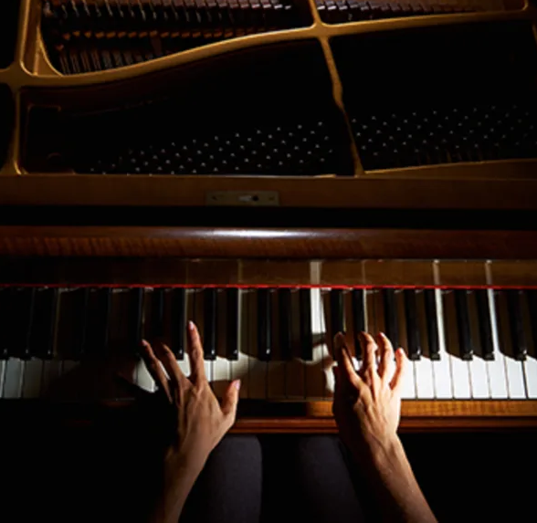
Design Thinking
Definition :
[In Music field], [When creating new music], [Not knowing what the fans want or what will make us hit the trend] ---> use data science to collect data and formulate a model that analyzes this data and learn what the fans like.
Notes:
Note:
8

Slide 9

Design Thinking
Analyze :
Creating Persona
I am a 20 year old student, I listen to music all the time, in hopes of becoming a musician in the future. I try to focus on my studies, because I am afraid that my songs might not become trends, so I would need another, more stable, source of income at then.
Notes:
Note:
9

Slide 10
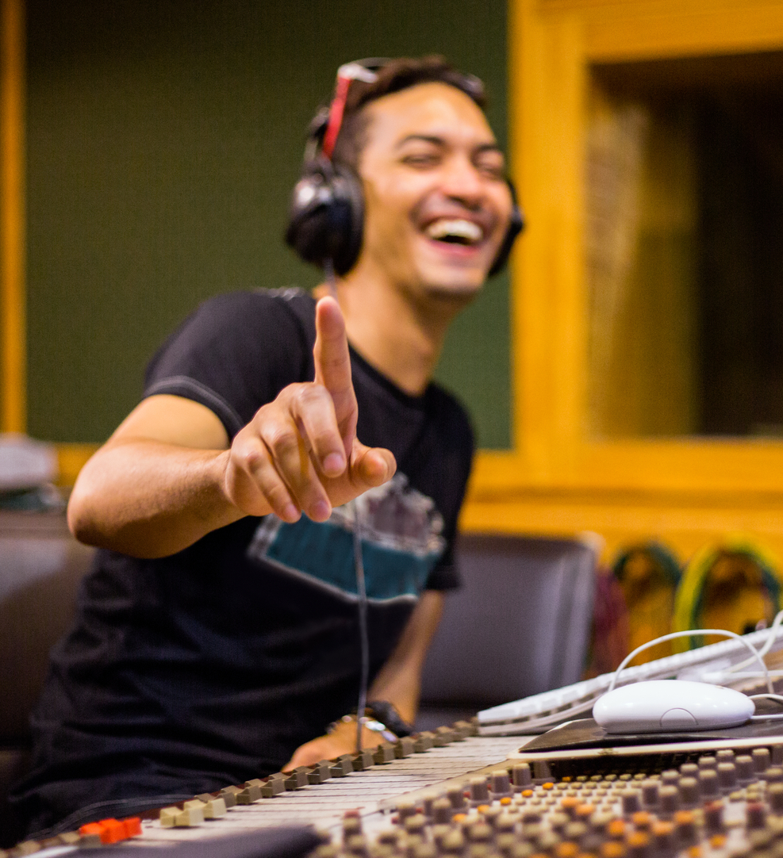
Design Thinking
Analyze :
Creating Persona
I am an experienced music author. I have been composing songs for over 10 years, but I still cannot find a formula for success. Some of my songs are popular, while others remain unknown. I sometimes wish I could figure out how my fans think, to know what they like.
Notes:
Note:
10

Slide 11
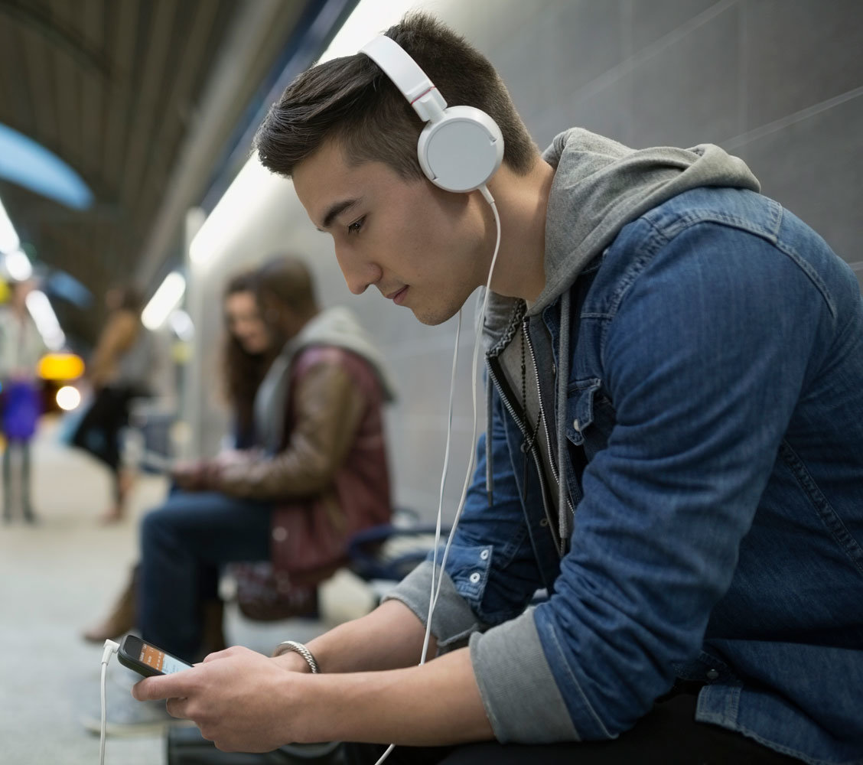
Design Thinking
DISCOVER :
People :
Most people listen to music while on the bus or in the metro, or even when studying sometimes. People rarely stop to solely listen to music, they're always doing something else at the same time.
Tools :
Most people use their headphones, so as not to disturb others, and also so as not to be disturbed. These headphones also work as ear mufflers.
Notes:
Note:
11

Slide 12
Design Thinking
DISCOVER :
Environment :
Headphones are usually manufactured in such a way that isolates the user from the surrounding environment. So all they need is a relatively safe environment, where their headphones won’t be stolen.
Activity :
People usually refrain from other activities that require communication while listening to music, so as not to get disturbed.
Notes:
Note:
12

Slide 13

Design Thinking
IDEATE & PROTOTYPE :
Many people listen to music, but this causes a lack of communication between people. That is why we thought of trying to find common ground between music and communication. An application that you can play with your friends, but still encompasses music.
This application will contain many different modes.
Notes:
Note:
13

Slide 14

Data Features
ALink :
Link to the song's artist page.
SName :
Song name.
SLink :
Link to the song's lyrics page.
Lyric :
The song's lyric.
Idiom :
The lyric’s idiom.
Notes:
Note:
14

Slide 15
Data Analysis
Lyric’s idiom
Total : 206375
English: 114723
Portuguese: 85085
Others : 6567
Notes:
Note:
15

Slide 16
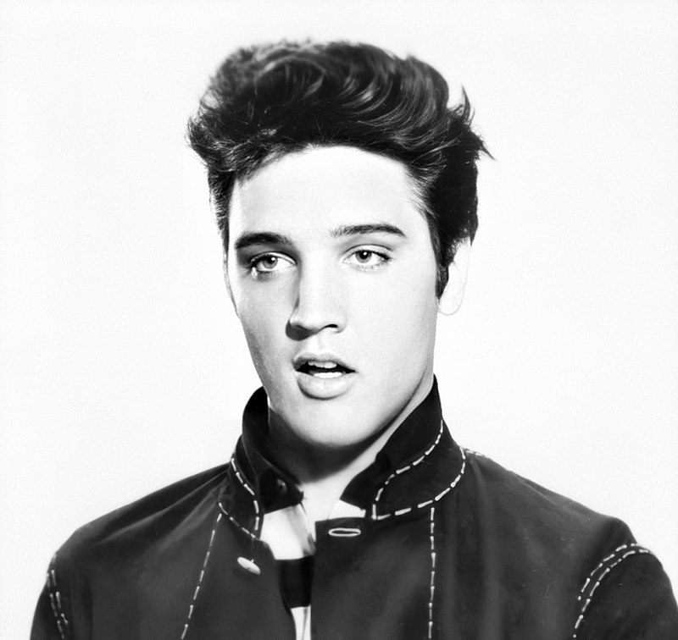
Data Analysis
Restricted by the memory, we decided to train our model on only the English language, and more specifically, the songs written by Elvis Presley. This choice was not arbitrary, we chose Elvis as his songs seemingly contained the most sensible sentence structures.
Notes:
Note:
16

Slide 17
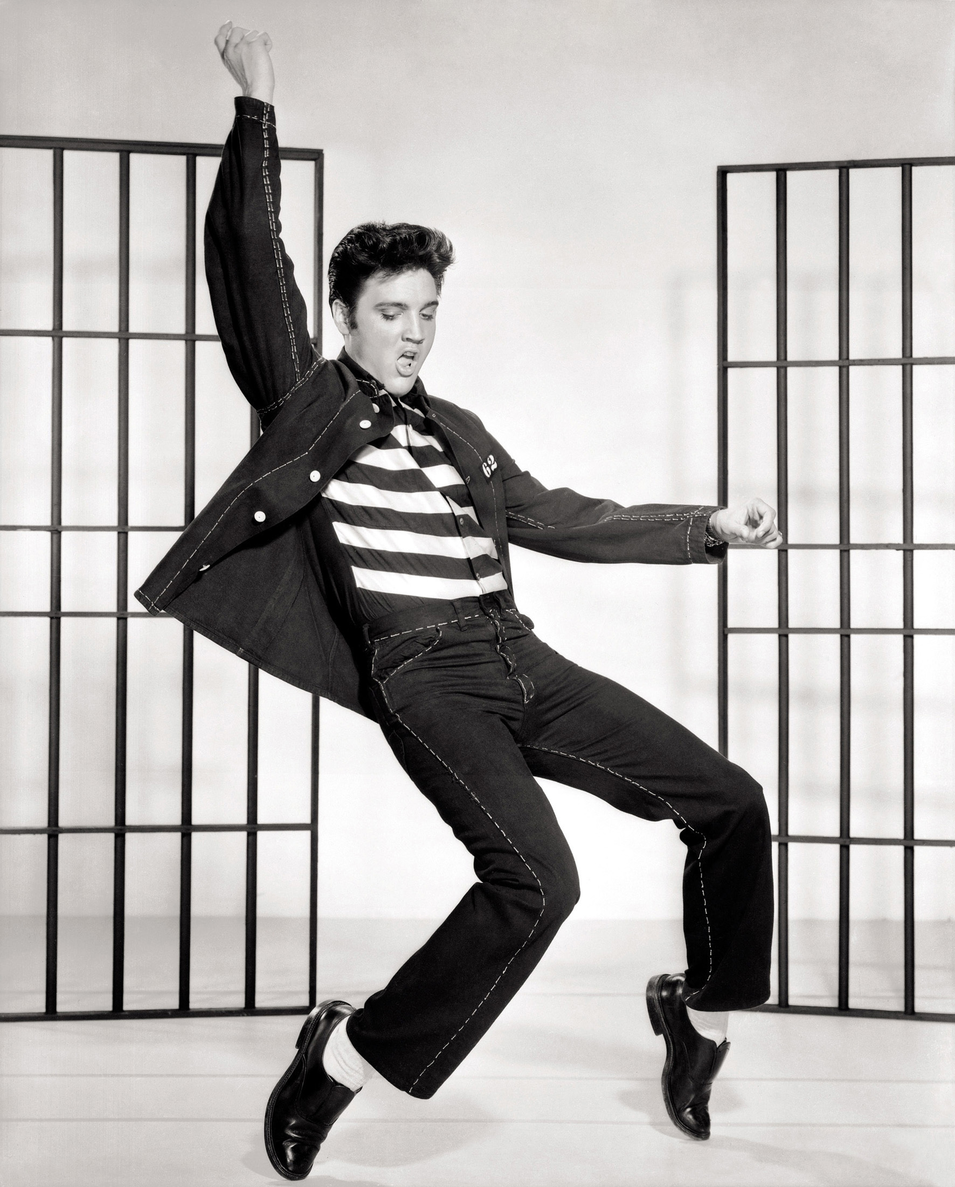
Data Analysis
Why Elvis Presley?
His songs seemingly contained the most sensible sentence structure.
Advantages
Reducing the model training time.
Increasing accuracy for prediction.
Avoid text abbreviations and insults(as in Modern Songs).
Notes:
Note:
17

Slide 18
Data Analysis
Songs Description
Count of songs 771
Mean number of words 155
Min number of words 17
Max number of words 452
Notes:
Note:
18

Slide 19
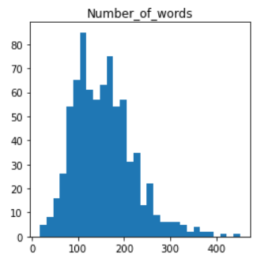
Data Analysis
Songs Description
Num of Words
Count of songs 771
Mean number of words 155
Min number of words 17
Max number of words 452
Notes:
Note:
19

Slide 20
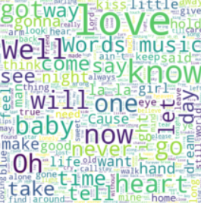
Data Analysis
Most Common Words
Love
Will
Well
Know
Now
Notes:
Note:
20

Slide 21
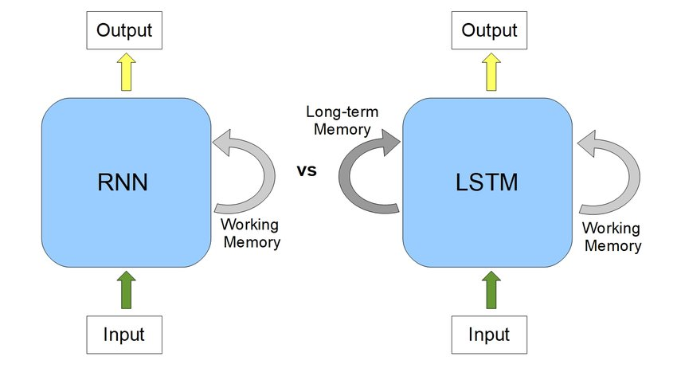
Modelling
Models Used
Simple RNN (Recurrent Neural Network) & LSTM (Long Short Term Memory)
Notes:
Note:
21

Slide 22
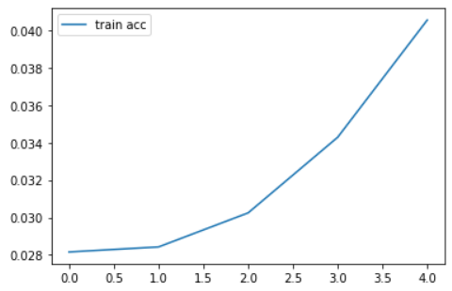
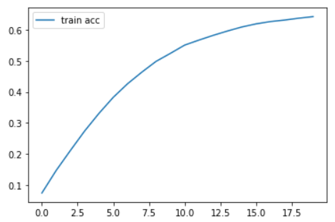
Modelling
Simple RNN
LSTM
Accuracy : 3.66%
Accuracy : 66.33%
Notes:
Note:
22

Slide 23
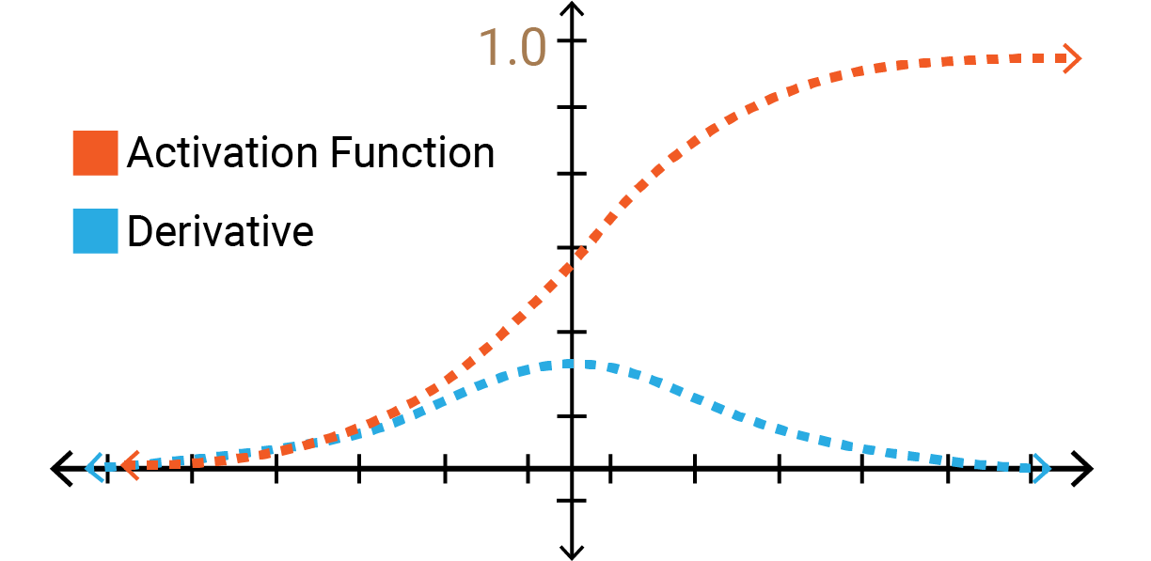
Modelling
Why such a huge difference?
The huge difference in accuracy stems from the fact that Simple RNN does not retain its long term memory. So it forgets the old words, which makes its predictions much less accurate. As opposed to LSTM, which has a long term memory, so it uses the old words in predicting new ones.
Notes:
Note:
23

Slide 24

RNN Predictions
Input
Words : I must tell you about
Num of Words : 40
Output
I must tell you about you don't know you don't know you don't know you don't know you don't know you don't know you don't know you don't know you don't know you don't know you don't know you don't know you don't know you.
Notes:
Note:
24

Slide 25

LSTM Predictions
Input
Words : Never have I ever
Num of Words : 51
Output
Never have I ever know what you do not what I need anymore I don't care why are you say I would fade down but I know you dig up but baby I can't understand another day why can't you leave me just already so reason to take myself free but I won't believe you.
Notes:
Note:
25

Slide 26

LSTM Predictions
Input
Words : I love you
Num of Words : 40
Output
I love you so i lie and i lose the door of you i know that i love you so how i have lost my own hand and the memory of your love and the one who knew.
Notes:
Note:
26

Slide 27

Business Solutions
Target users
Beginners and casual users
Professional users
Recommendations and Suggestions
Casual users will be able to insert text input, and the model would generate lyrics starting with that text. The users would then be prompted to rate those lyrics, and modify the parts they did not like. Users have the choice to share their lyrics with friends and other users, and get their lyrics rated.
Notes:
Note:
27

Slide 28

Business Solutions
Recommendations and Suggestions
Data obtained from casual users will then be analyzed to figure out some patterns of what songs people like. This data can then be sold to professional users and music composers so that they would know what pleases their fans.
We will also store this data, and the model would train on it, so as to improve its accuracy and learn from our users. This will help elevate our users' experience by generating more artistic lyrics, that sound like they came from real humans, instead of machine generated lyrics.
Notes:
Note:
28

Slide 29

Business Solutions
Recommendations and Suggestions
Our generated lyrics can be integrated with other music applications, where music composers would be free to make songs using our lyrics. These songs would then be played in the applications like any other human-made song. This may be used in our initial stage, as a kind of advertisement for our application.
Notes:
Note:
29

Slide 30
Thank You
Notes:
Note:
30

